Slide 2
Human Capital refers to the skill, ability, education and knowledge possessed by an individual or a society.

Slide 3
HUMAN CAPITAL

Slide 4
PHYSICAL CAPITAL | HUMAN CAPITAL
Man made means of production | Skill, ability, education and knowledge possessed people
Tangible and can be sold in the market | Intangible, cannot be sold. Only services can be provided.
It is more mobile between countries | It is less mobile between countries
Can be separated from the owner | It is built in the body and mind of owner. Cannot be separated.
It depreciates with the passage of time | Depreciation can be reduced by investing in education and training.

Slide 5
HUMAN CAPITAL | HUMAN DEVELOPMENT
It is a narrow concept | It is a broader concept
It considers education and health as means to increase labour productivity | It considers education and health as factors needed for the wellbeing of human beings
It treats human beings as means to an end | Human beings are end in themselves

Slide 6
HUMAN CAPITAL FORMATION: Steps taken for the development of abilities skill and knowledge among the people of a country. Education, Training and Health Care contributes to Human Capital Formation.

Slide 8
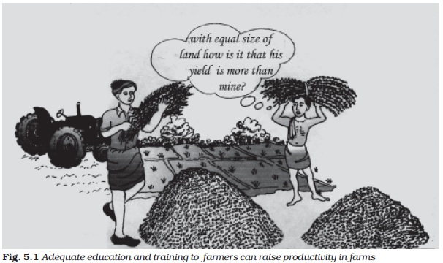
FACTORS THART CONTRIBUTES TO HUMAN CAPITAL FORMATION
EDUCATION
UNEDUCATED FARMER
EDUCATED FARMER

Slide 9
EDUCATION
An educated man earn higher income. He enjoys good social status
An educated man contributes more to production process. His efficiency and productivity are high.
Educated people contributes towards towards the development of Science and Technology.
Educated and skilled workers can easily adopt modern technology.
They possess good human values and work culture.
They have better knowledge about investment opportunities. They may become entrepreneurs.

Slide 10
2. HEALTH

Slide 11
HEALTH

Slide 12
A healthy person will be regular to his works. He will not take much leave from work.
Efficiency and productivity in work will be more if a person is healthy.
A healthy person can be creative. He will think about positive changes in his work.
A healthy person earns higher income and leads a good standard of living.
An unhealthy person is a burden to the society. Society needs to spend a lot of money on him.
Preventive medicines such as vaccination will keep the society healthy.
Health awareness and supply of safe drinking water will enhance the health condition of the society.

Slide 14
ON THE JOB TRAINING
Organisations should provide on the job training to their employees in order to keep them updated.
The firm itself can give training to its employees.
The workers can be send outside also for training.

Slide 15
IMPORTANCE OF ON THE JOB TRAINING
It will help workers to come in contact with the new developments in technology.
It sharpens the skill of workers and improves their efficiency and productivity.
It enables the newly appointed employees to acquire practical knowledge about the methods of production.
It motivates the employees and develops a good work culture.

Slide 16
MIGRATION

Slide 17
MIGRATION
People migrate in search of jobs and other economic opportunities.
There is large scale migration from rural to urban areas. Technically qualified people migrate to other countries.
People earn higher income in the migrated lands.
They make additions to the Human Capital of the migrated land.
So, expenditure on migration is also a source of Human Capital Formation.

Slide 18
INFORMATION

Slide 19
INFORMATION
Information about labour market and educational institutions is necessary to take decisions regarding investment in human capital and also for the better utilisation of available human capital. So, money spent on information is also a source of human capital formation.

Slide 21
Increase in GDP: An educated and healthy man Earns more income than an uneducated person. He contributes more to production process and faster economic development.
Effective use of physical capital. Educated, skilled and heathy people use the physical capital in an effective manner and raise the productivity of capital.
Inventions , innovations and technological improvement take place in a country which has good quality human resources.

Slide 22
Increases life expectancy: Formation of human capital raises life expectancy of the people. Health facilities and availability of nutritive food enable people to live a healthy and long life. This in turn, adds to the quality of life.
Improves Quality of life: Educated and healthy people lead a good quality life.
Control of population growth: It has been observed that educated persons have smaller families as compared to illiterate families. So, spread of education is necessary to control the population growth rate.

Slide 23
REPORT BY DEUTSCHE BANK

Slide 24
It is a German Bank. It published a report titled Global Growth Centers on 01/7/2005.
This report identified India as one of the major growth centers by 2020.
Human Capital is the most important factor that determines economic growth. Increase in human capital leads to increase in GDP.
Between 2005 and 2020, there will be 40% rise in the average years of education in India.

Slide 25
REPORT BY WORLD BANK (IBRD)

Slide 26
India must develop in to a Knowledge Economy – World Bank
The knowledge economy is the use of knowledge to create goods and services. It reefers to development of skilled and educated manpower in order to take the country to progress. Best Example is Japan

Slide 27
World Bank published a report titled, India and the knowledge economy – Leveraging Strengths and Weaknesses.
It states that India should make a change to the knowledge economy.
If India uses its knowledge like Ireland, then the per capita will increase from US$ 1000 (2002) to US $ 3000(2020).
India has everything needed for this change. There are large number of skilled workers, a well functioning democracy and a diversified science and technology infrastructure.
IT sector is well developed in India.
E Governance is already introduced.

Slide 29
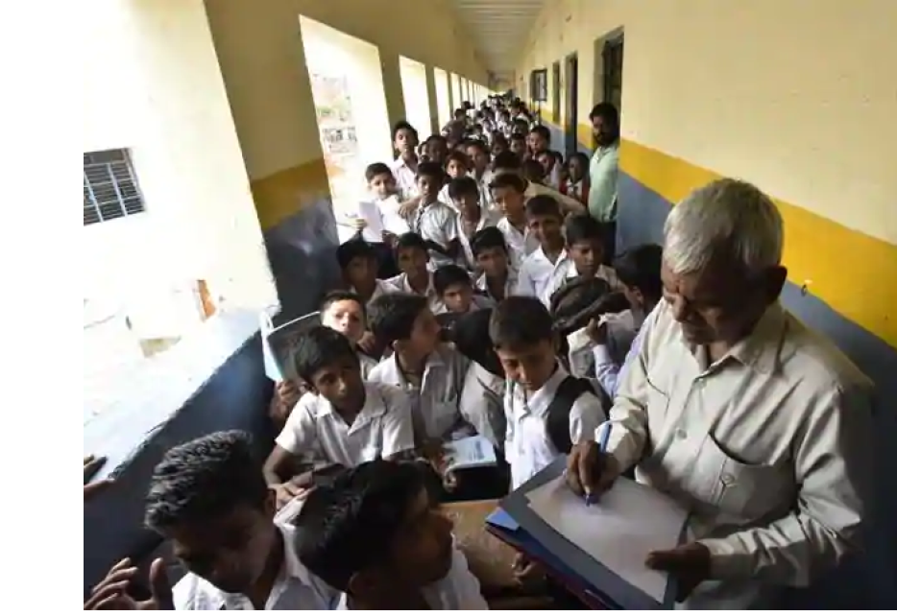
Rapid Growth of Population: It reduces per capita availability of education, health and other facilities.

Slide 30
Brain Drain: Migration of educated, skilled and talented people to developed countries reduces the quality of human resources of India.

Slide 31
Unscientific Man Power Planning: The educational system is not tailored according to the demands of the job market. We have the problem of educated unemployment on one side and the scarcity of skilled men of certain categories on the other hand.

Slide 32
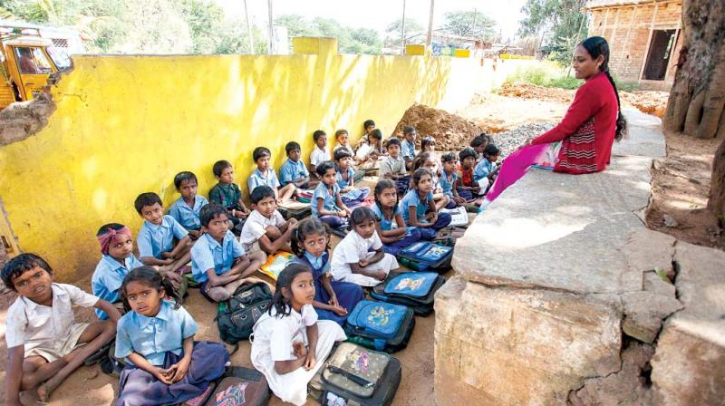
Low Academic Standards: The quality of education imparted by many of our educational institutions is far below the international standards.

Slide 33
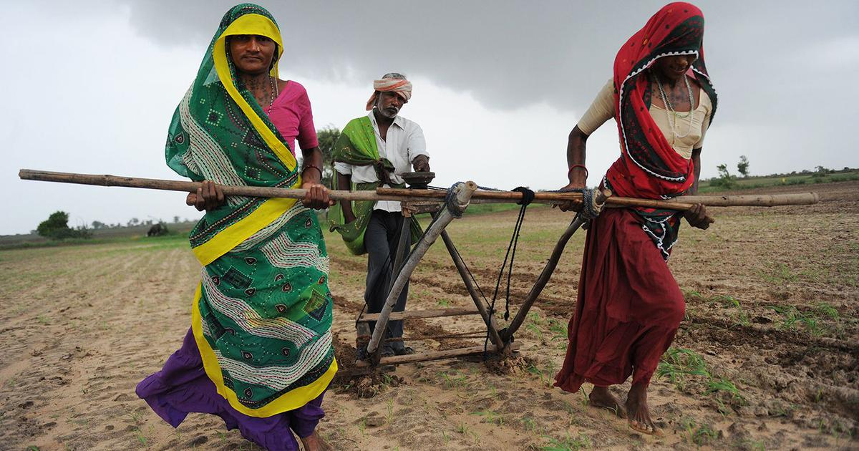
Lack of On the Job Training in Primary Sector: The facilities to train the farmers are inadequate in our country. Many of our farmers are unaware of the modern methods of cultivation.
No knowledge about modern methods

Slide 34
STEPS TO OVERCOME THE PROBLEMS FACED BY HUMAN CAPITAL FORMATION

Slide 35
Steps should be taken to prevent Brain Drain. Employment and business opportunities should be provided to skilled and talented people. Research and development facilities have to be developed.

Slide 36
Technical education has to be given more importance. Technically educated people find it easy to get employment. The Government should set up technical institutes with all the required infrastructural facilities. The quality of education has to be improved.

Slide 37
Secondary education has to be made free and compulsory. This will help to create well informed citizens.

Slide 38
The Government investment in health sector should be increased. Health care should be made affordable to the poorer sections of the society.

Slide 39
Higher education should be made affordable to all sections of the society. The quality of higher education has to be improved.

Slide 40
Proper work culture has to be developed among the people. They have to be motivated to make contributions towards nation building.

Slide 41
Steps should be taken to provide education and training to the farmers.

Slide 42
IMPORTANCE OF GOVERNMENT INTERFERENCE IN EDUCATION AND HEALTH CARE

Slide 43
IMPORTANCE OF GOVERNMENT INTERFERENCE IN EDUCATION AND HEALTH CARE
Expenditure on education and health makes long term impact. They cannot be easily reversed. So, Government interference is necessary to ensure quality.
Common people do not know about the quality of services provided by educational and health care institutions. Government interference will ensure quality services at affordable prices to the people.
Basic education and health care are the rights of citizens. So, it is the duty of the Government to provide them free of cost to the poor people.

Slide 44
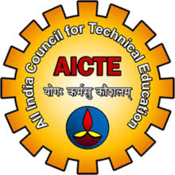
INSTITUTIONS THAT FACILITATE AND GUIDE EDUCATIONAL INSTITUTIONS IN INDIA

Slide 45
GOVERNMENT EXPENDITURE ON EDUCATION
AS A PECENTAGE OF GDP
AS A PERCENTAGE OF TOTAL GOVERNMENT EXPENDITURE
7.9% IN 1952
15.7% IN 2014
0.64% IN 1952
4.13% IN 2014

Slide 46
Largest part of Government expenditure is on Primary Education.
Expenditure per student is highest in tertiary education(Higher Education).
Inter- State variations in per capita expenditure on elementary education
Rs. 34651 in Rs. 4088 in
Himachal Pradesh Bihar

Slide 47
Expenditure on Education is insufficient in India
The Education Commission recommended that at least 6% of the GDP should be spent on education. Our expenditure is less than 4%.
Tapas Majumdar Committee recommended that the Government should spend at least 1.37lakh crore during a period of 10 years(1998 -99 to 2006 – 07) to provide education to all the children below 14 years. We failed to spend that much amount of money.

Slide 48
Achievements of India in the field of Education
Male literacy : 61.9% in 1990 to 81% in 2015
Female Literacy: 37.9% in 1990 to 63% in 2015
Primary Education completion Rate:
Males – 78% in 1990 to 94% in 2015.
Females: 61% in 1990 to 99% in 2015
Youth Literacy rate: Males – 76.6% in 1990 to 92% in 2015
Females- 54.2 % in 1990 to 87% in 2015.

Slide 49
IMPORTANCE OF WOMEN’S EDUCATION IN INDIA

Slide 50
IMPORTANCE OF WOMEN’S EDUCATION IN INDIA
Women constitute nearly 50% of the population. They are valuable human resources. Educating them will help in the economic development of our country.
Education will contribute to women empowerment and achieving the goal of gender equality.
It will help in better care for children and reduction in infant mortality rate.
It will reduce child marriages and promote small family norm. Population growth rate will be controlled.
Women will become economically independent.
It will reduce domestic violence and dowry harassment.

Slide 51
IMPORTANT ELEMENTS OF FUTURE EDUCATIONAL POLICY IN INDIA
Education for All: Free and compulsory education for all children below 14 years of age is one of the Directive Principles of State Policy. In 2019, Right to education Act was passed to achieve this goal. Sarvashiksha Abhyan is launched (Operation Black Board) and Mid – day meal is provided. Still, this goal is not achieved.

Slide 52
Gender Equality: traditionally. Education of women is neglected in India. Literacy rate among women is less than that of men. In higher education also, women’s representation is very less. Recently, this gap has been reducing. Still, we need to work towards this goal.
Higher Education: Very less number of people go for higher education in India. The fees is very high and not affordable to the poor people. The Government has to make investment and make Higher education affordable for all.

